Slide 1

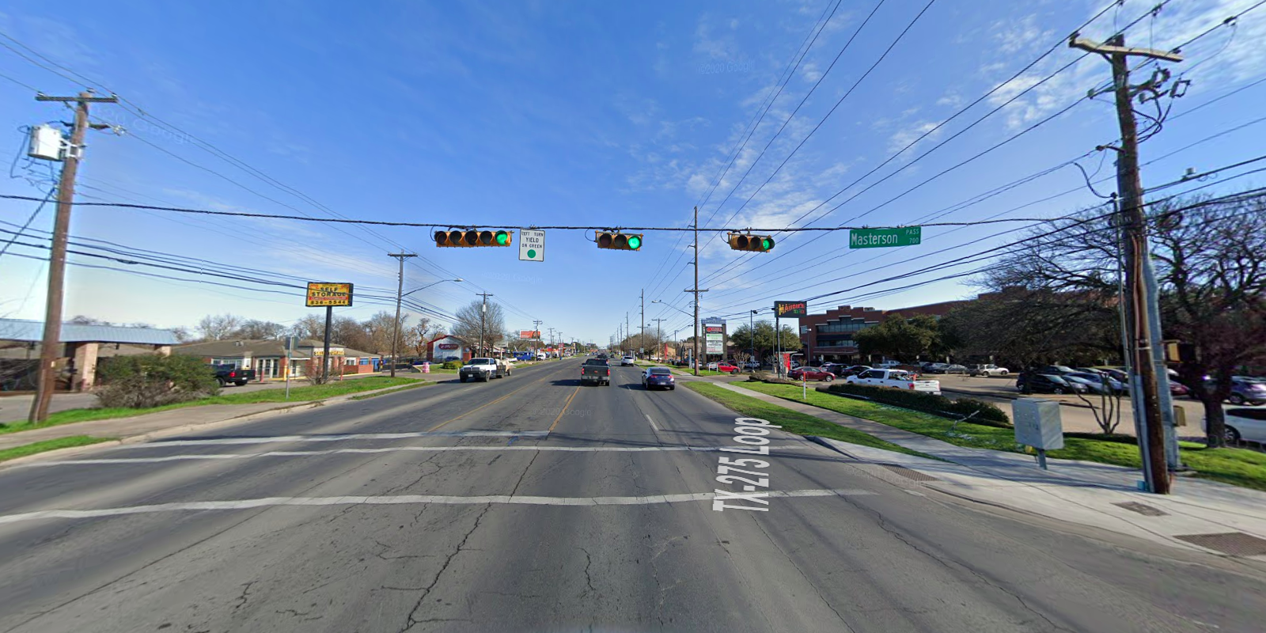
Austin Transportation Department Signs Work Orders
Created By: Susanne Gov Created Date: 2020-05-21 Location Name: LAMAR BLVD / MASTERSON PASS Intersection ID: 5162641 Cardinal Direction: N
Sign Type | Install/Remove
Street Name Sign | Install
Left Turn Yield On Green | Install

Slide 2
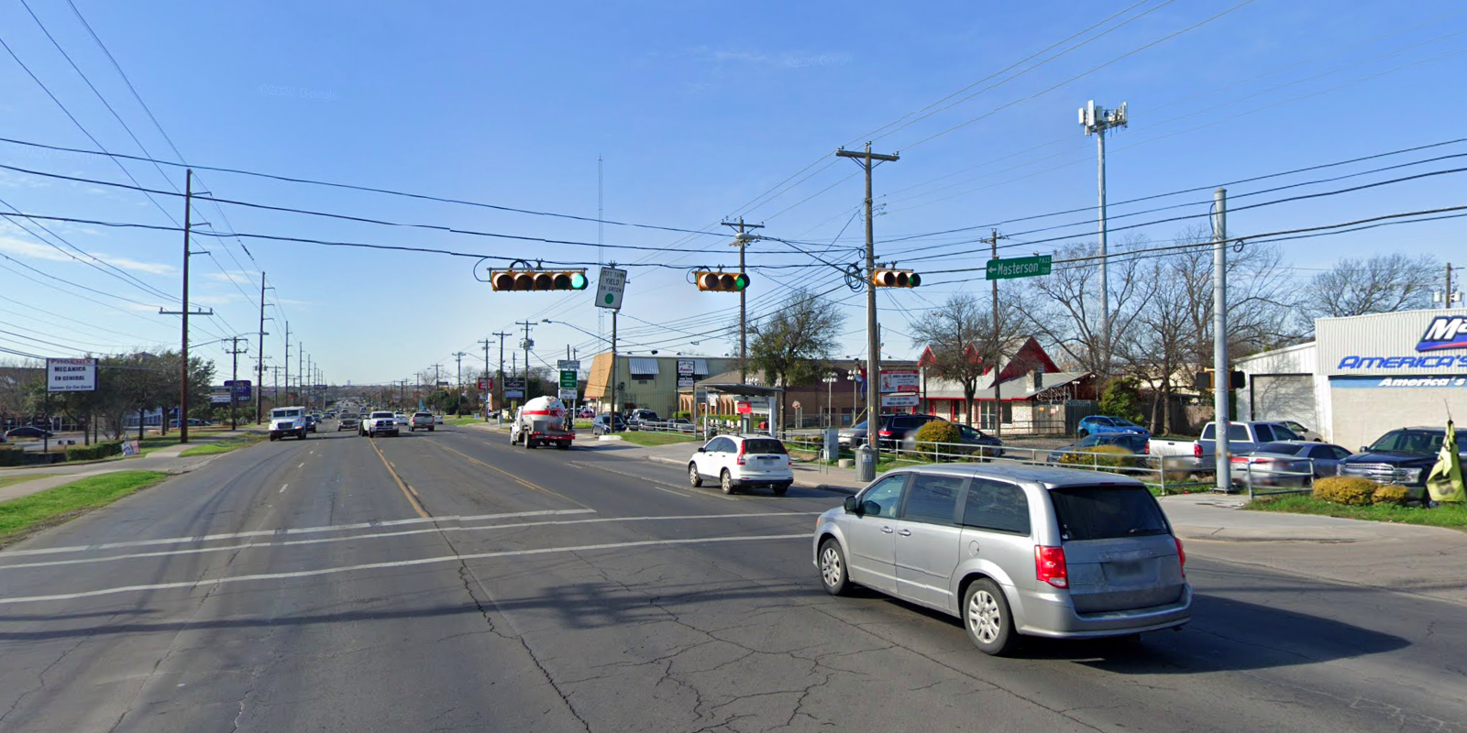
Austin Transportation Department Signs Work Orders
Created By: Susanne Gov Created Date: 2020-05-21 Location Name: LAMAR BLVD / MASTERSON PASS Intersection ID: 5162641 Cardinal Direction: S
Sign Type | Install/Remove
Left Turn Yield On Green | Install
Street Name Sign | Install

Slide 3
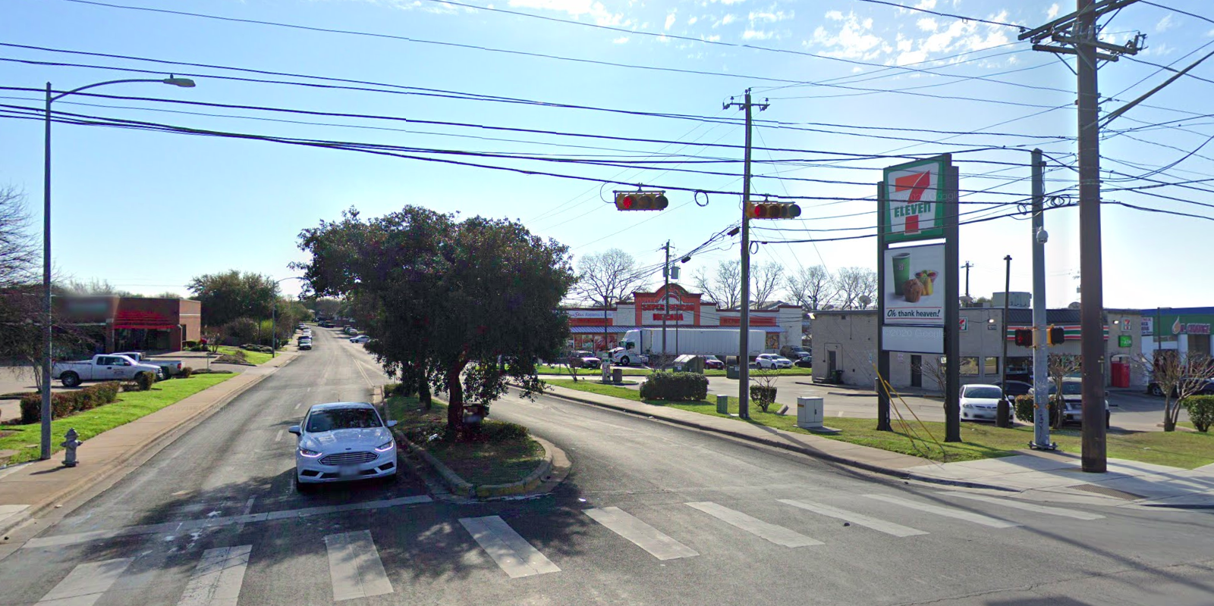
Austin Transportation Department Signs Work Orders
Created By: Susanne Gov Created Date: 2020-05-21 Location Name: LAMAR BLVD / MASTERSON PASS Intersection ID: 5162641 Cardinal Direction: E
Sign Type | Install/Remove

Slide 4
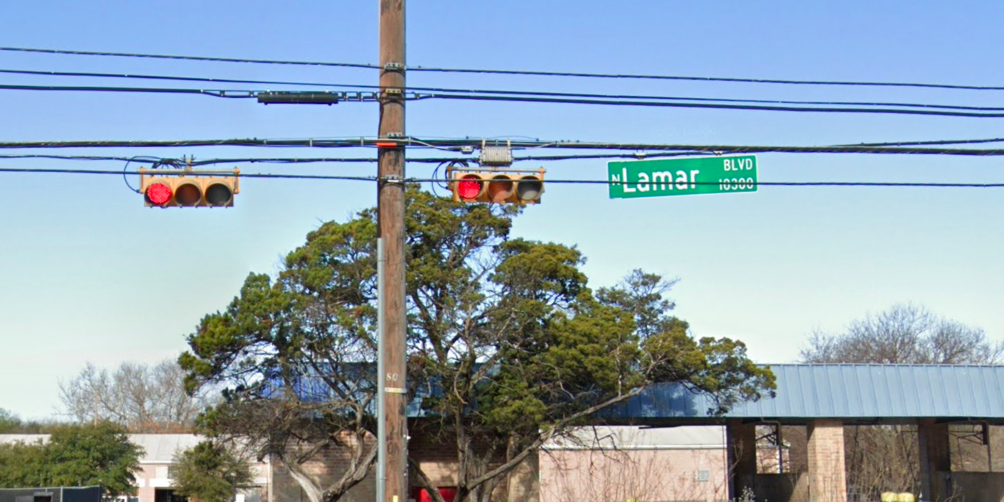
Austin Transportation Department Signs Work Orders
Created By: Susanne Gov Created Date: 2020-05-21 Location Name: LAMAR BLVD / MASTERSON PASS Intersection ID: 5162641 Cardinal Direction: W
Sign Type | Install/Remove
Street Name Sign | Install

